Slide 1
Topics To Be Covered
Asymptotic Analysis – Part I
Orders of Growth
  Big Oh Notation
  Omega Notation
  Theta Notation

Slide 2
Comparing Algorithms
Let us suppose that we perform an analysis of the (worst case) time complexity of algorithms A and B to obtain functions f_{A}(n) and f_{B}(n).
How do we compare the two functions to arrive at a decision on which of A or B to implement?

Slide 3
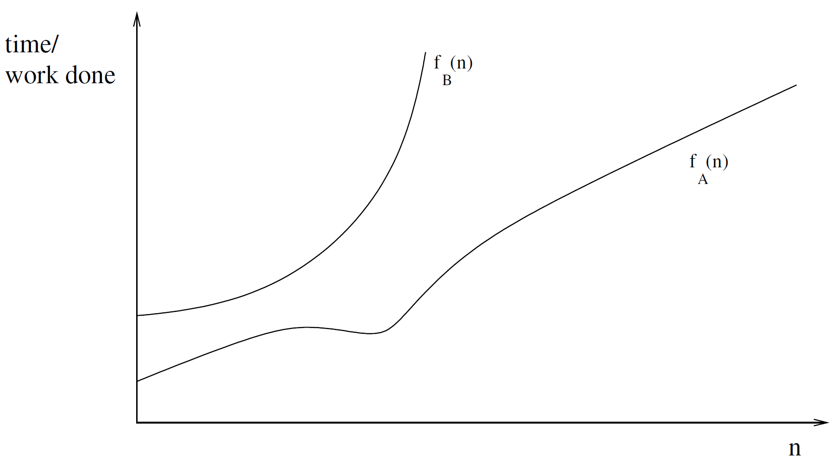
Comparing Algorithms
One way that f_{A}(n) and f_{B}(n) might compare with each other.

Slide 4
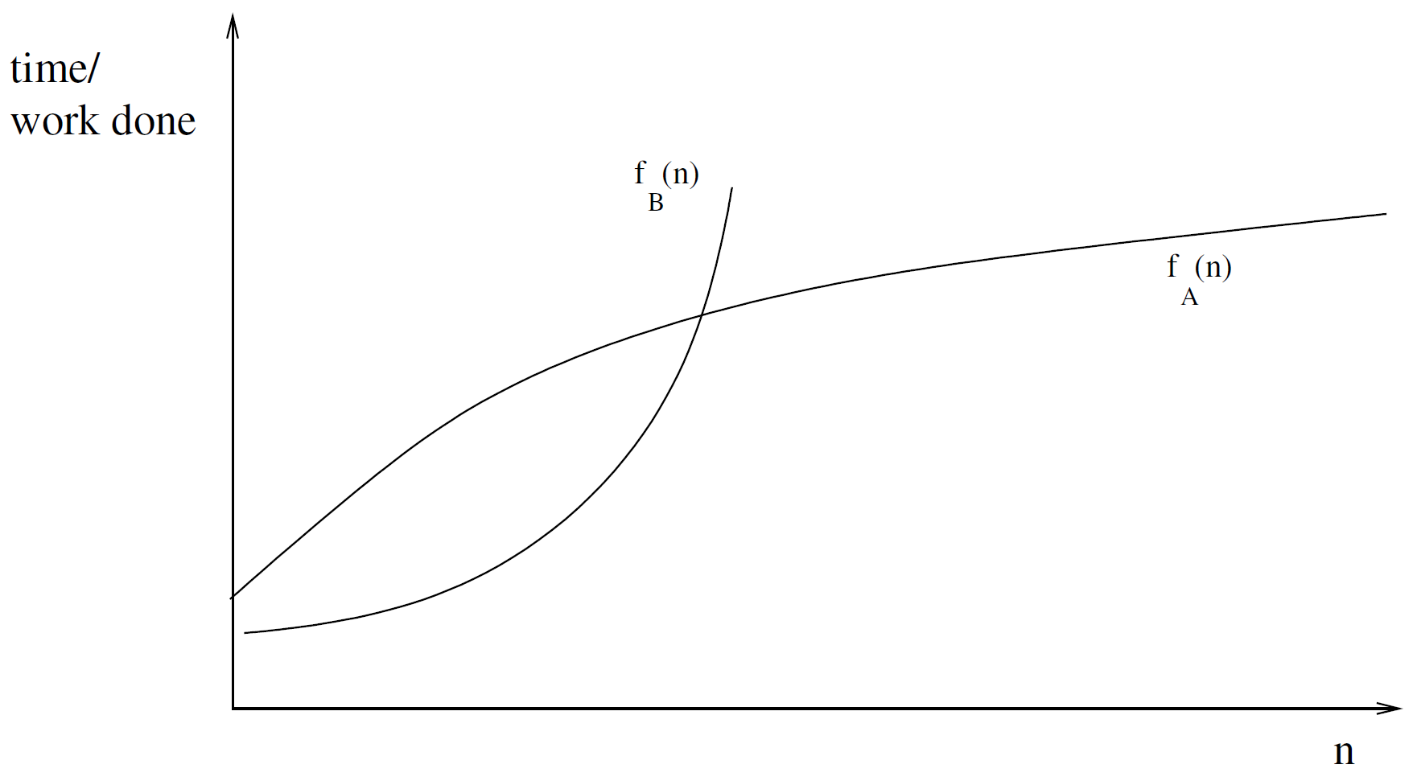
Comparing Algorithms
Another way that f_{A}(n) and f_{B}(n) might compare with each other.

Slide 5
Comparing Algorithms
The decision would seem to be less obvious in the second case because it depends on which values of input size, n.
In general, we make a simplifying assumption that we care how an algorithm performs on large values of n.
Furthermore, our deliberations will not be clouded by differences in algorithm implementation, such as processor speed.

Slide 6
Comparing Algorithms
Mathematics provides a way to carry out this type of comparison of functions.
It is called
Asymptotic Analysis
because it compares functions
based on their behaviour on
very large input values.

Slide 7
Asymptotic Analysis - Review
Complexity: the amount of time and/or space needed to execute the algorithm.
Complexity may be expressed in terms of its relationships to some known functions.
Asymptotic Analysis
examines various types of complexity

Slide 8
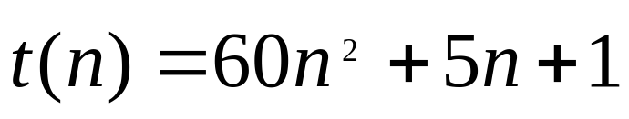
Asymptotic Analysis - Review
  Consider the function,
n | t(n) = 60n² + 5n + 1 | 60n² ^{(lower limit)} | 66n² ^{(upper limit)}
10 | 6,051 | 6,000 | 6,600
100 | 600,501 | 600,000 | 660,000
1,000 | 60,005, 001 | 60,000,000 | 66,000,000
10,000 | 6,000,050,001 | 6,000,000,000 | 6,600,000,000

Slide 9
Asymptotic Analysis
Let f and g be functions that could arise from a (time) complexity analysis of an algorithm.
Let n denote the input to each of these functions
(so n represents the size of the input to the algorithms whose analyses produced f and g).
We shall concentrate on the relative values of f and g for large values of n.
We examine how f changes as n increases, and compare that growth of f with the growth of g.
We shall consider them to be significantly different only if the ratios f(n)/g(n) of their corresponding values on increasing values of n become either infinity or zero.

Slide 10
Asymptotic Analysis
The ratios f(n)/g(n) will tend to three (3) possibilities:
Zero (0)
  when f grows significantly slower than g
Infinity (∞)
  when f grows significantly faster than g
A finite non-zero number
  when they have equivalent growth rates.
The classification into
zero, finite or infinity
is so important that specific notations have been invented to represent the various situations.

Slide 11
Asymptotic Analysis
We can regard O, Ω, Θ as relations on functions that are analagous to the relations ≤, ≥, = on numbers.
When we use the notations e.g. f = Θ(g), we sometimes say that “f(n) grows on the order of g(n)” or that “f(n) has order of growth g(n)”.
The Order of Growth of a function is the rate at which it increases, up to a constant, with increasing input size.

Slide 12
Types of Complexity: Big Oh
Definition: Big Oh Notation
Let f and g be functions with domain {1,2,3,….}
f(n) = O(g(n))
means
“f(n) grows no faster than g(n)”
We say that
“f(n) is of order at most g(n)”
if ∃ a positive constant C₁ such that
|f(n)| ≤ C₁|g(n)|
∀ but finitely many positive integers n.

Slide 13
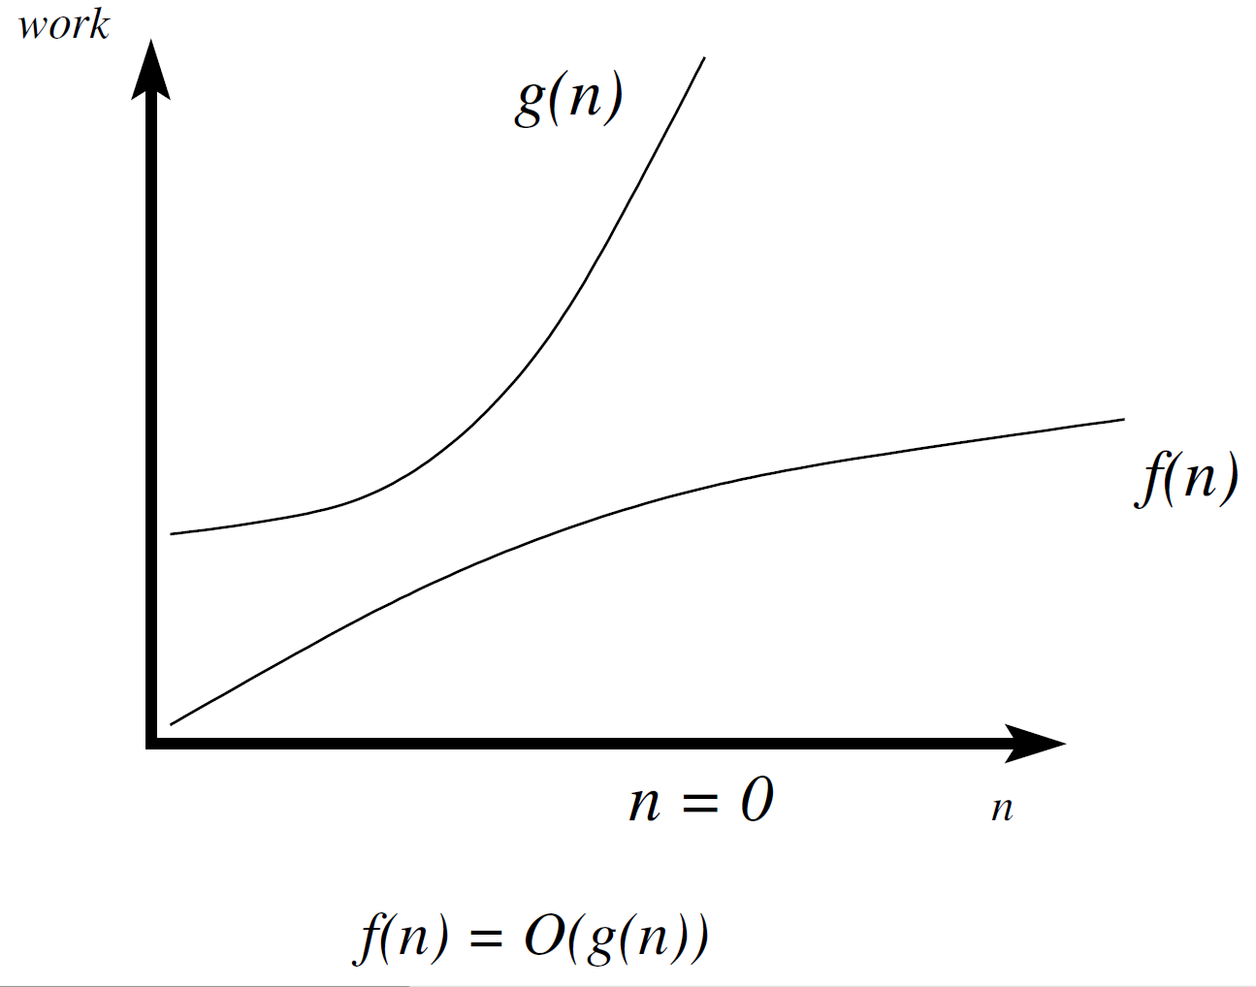
Types of Complexity: Big Oh

Slide 14
Types of Complexity: Omega
Definition: Omega Notation
Let f and g be functions with domain {1,2,3,….}
f(n) = Ω(g(n))
means
“f(n) grows at least as fast as g(n)”
We say that
“f(n) is of order at least g(n)”
if ∃ a positive constant C₁ such that
|f(n)| ≥ C₁|g(n)|
∀ but finitely many positive integers n.

Slide 15
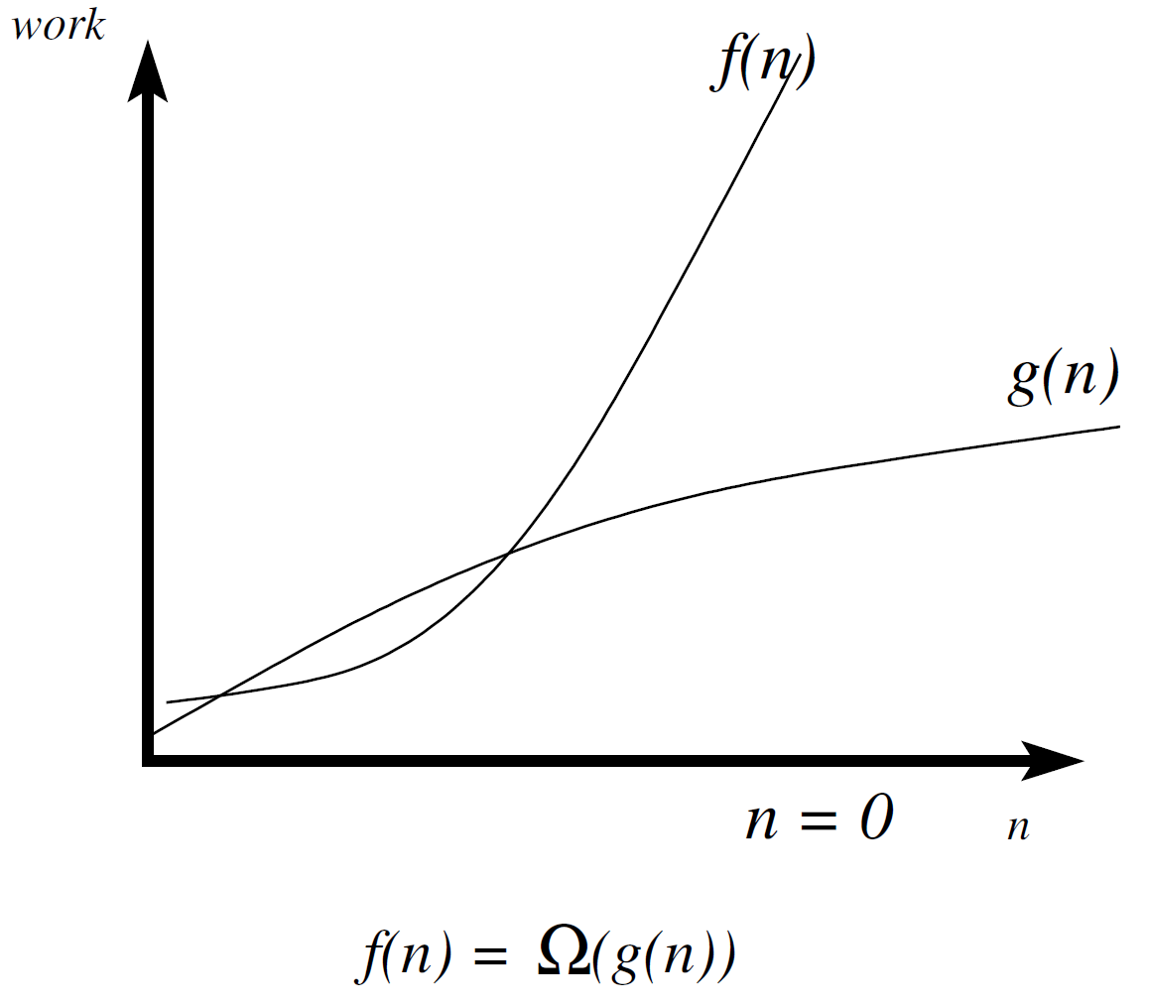
Types of Complexity: Omega Notation

Slide 16
Types of Complexity: Theta
Definition: Theta Notation
Let f and g be functions with domain {1,2,3,….}
f(n) = Θ(g(n))
means
“f(n) grows at approx. the same rate as g(n)”
and
f(n) = O(g(n)) and f(n) = Ω( g(n))
We say that
“f(n) is of order g(n)”
if ∃ positive constants C₁ and C₂ such that
C₁|g(n)| ≤ |f(n)| ≤ C₁|g(n)|
∀ but finitely many positive integers n.

Slide 17
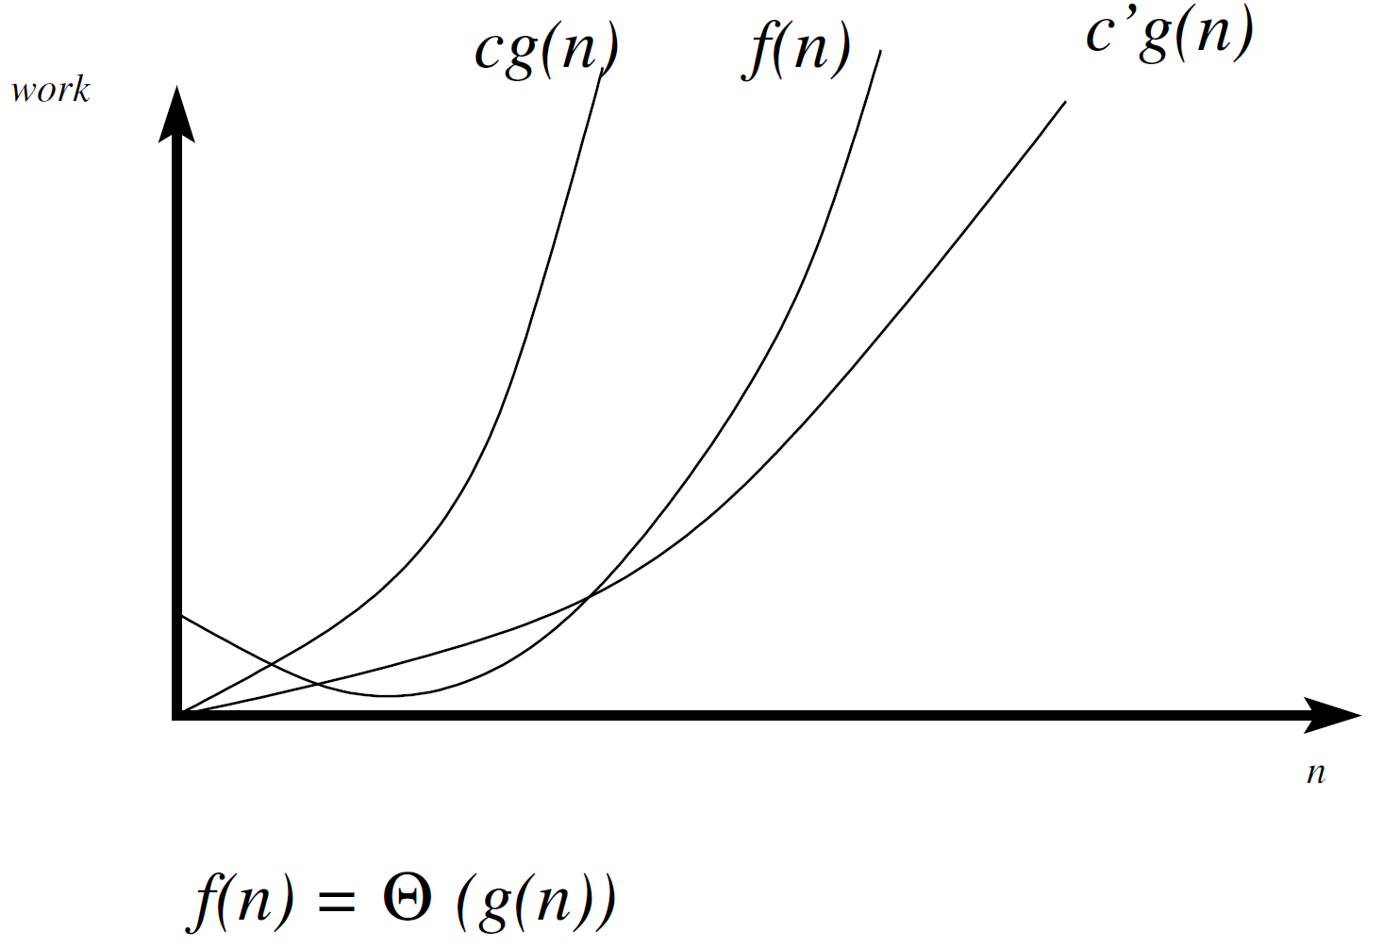
Types of Complexity: Theta Notation

Slide 18
Some Asymptotic Properties
Properties that can be proven:
O(g(n)), for example, O(n²) actually refers to the infinite set of functions that do not grow asymptotically faster than n²; examples of functions in this set include n, 2n+1, √n, n^{1.5}, 1, 10000, n lg n, lg n, etc.
Likewise, Ω(g(n)) refers to all functions that grow at least as fast as g(n).
In any polynomial function, the highest order term dominates the order of growth
e.g. Θ(3n² + 1000n + 100000) = Θ(n²)
Exponential functions grow much faster than any polynomial
e.g. Θ(2^{n} + n⁵⁰) = Θ(2^{n})
Polynomial functions grow much faster than any logarithms
e.g. Θ(n + lg²n) = Θ(n)

Slide 19
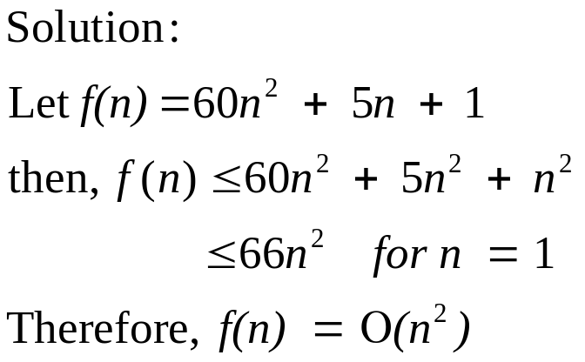
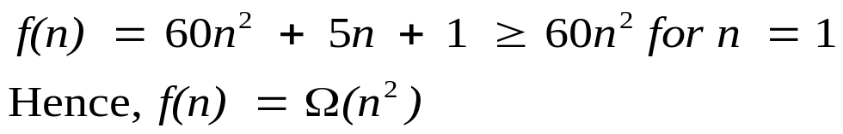
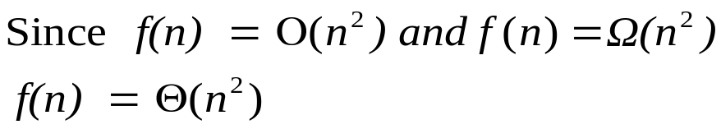
Complexity - Review
Example: Show that 60n² + 5n + 1 is of order n²

Slide 20
Topics Covered
Asymptotic Analysis – Part I
Orders of Growth
  Big Oh Notation
  Omega Notation
  Theta Notation

